Slide 1
COAL Chapter 1,2,3
Week 1 to 3
Dr. Muhammad Nouman Durrani

Slide 2
Assembly Language
Assembly language consists of statements
written with short mnemonics such as ADD, MOV, SUB, and CALL.
Assembly language has a one-to-one
relationship with machine language:
Each assembly language instruction corresponds to a single machine-language instruction.

Slide 3
High-level languages such as C++ and Java have a one-to-many relationship with assembly language and machine language.
A single statement in C++ expands into multiple assembly language or machine instructions.
The following C++ code carries out two arithmetic operations and assigns the result to a variable. Assume X and Y are integers:
int Y;
int X = (Y + 4) * 3;

Slide 4
Example: int Y; int X = (Y + 4) * 3;
Following is the equivalent translation to assembly language.
The translation requires multiple statements because assembly language works at a detailed level:
mov eax,Y ; move Y to the EAX register
add eax,4 ; add 4 to the EAX register
mov ebx,3 ; move 3 to the EBX register
imul ebx ; multiply EAX by EBX
mov X,eax ; move EAX to X
Registers are named storage locations in the CPU that hold intermediate results of operations

Slide 5
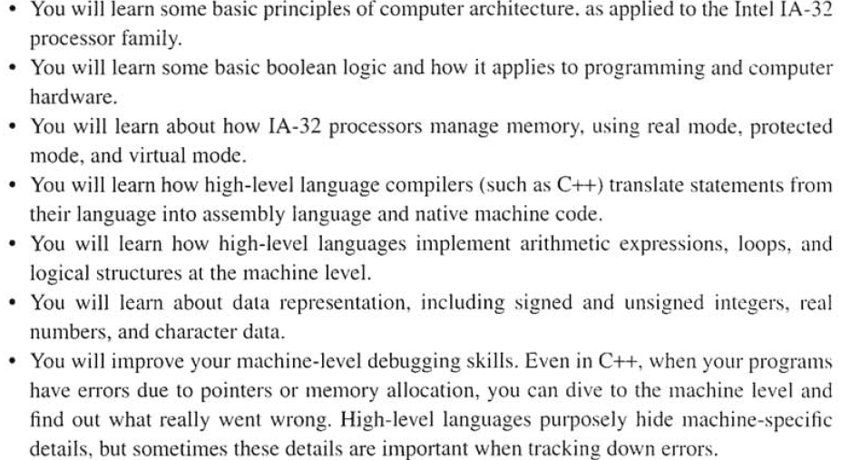
What you’ll learn?

Slide 6
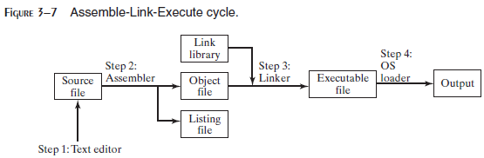
What Are Assemblers and Linkers?
Assembler is a utility program that converts source code programs from assembly language into an object file, a machine language translation of the program. Optionally a Listing file is also produced. We’ll use MASM as our assembler.
The linker reads the object file and checks to see if the program contains any calls to procedures in a link library. The linker copies any required procedures from the link library, combines them with the object file, and produces the executable file. Microsoft 16-bit linker is LINK.EXE and 32-bit is Linker LINK32.EXE.
OS Loader: A program that loads executable files into memory, and branches the CPU to the program’s starting address, (may initialize some registers (e.g. IP) ) and the program begins to execute.
Debugger is a utility program, that lets you step through a program while it’s running and examine registers and memory
MASM provides CodeView, TASM provides Turbo Debugger and msdev.exe for 32-bit Window console programs.

Slide 7
Listing File
A listing file contains:
a copy of the program’s source code,
with line numbers,
the numeric address of each instruction,
the machine code bytes of each instruction (in hexadecimal), and
a symbol table.
The symbol table contains the names of all program identifiers, segments, and related information.

Slide 8
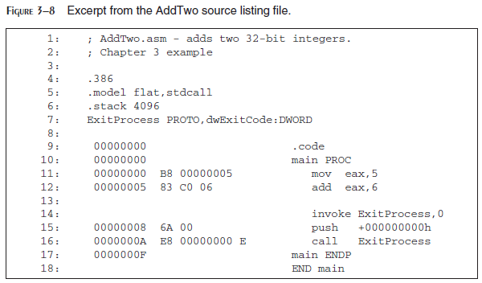

Slide 9
Assembly Language for x86 Processors
Assembly Language for x86 Processors focuses on programming microprocessors compatible with the Intel IA-32 and AMD x86 processors running under Microsoft Windows.
Assembly language bears the closest resemblance to native machine language.
It provides direct access to computer hardware, requiring you to understand much about your computer’s architecture and operating system.

Slide 10
Is Assembly Language Portable?
A language whose source programs can be compiled and run on a wide variety of computer systems is said to be portable.
A C++ program, for example, should compile and run on just about any computer, unless it makes specific references to library functions that exist under a single operating system.
A major feature of the Java language is that compiled programs run on nearly any computer system.

Slide 11
Is Assembly Language Portable?
Assembly language is not portable because it is designed for a specific processor family.
There are a number of different assembly languages widely used today, each based on a processor family.
Some well-known processor families are Motorola 68x00, x86, SUN Sparc, Vax, and IBM-370.
The instructions in assembly language may directly match the computer’s architecture or they may be translated during execution by a program inside the processor known as a microcode interpreter.

Slide 12
Applications of Assembly Language
Embedded systems programs are written in C, Java, or assembly language, and downloaded into computer chips and installed in dedicated devices.
Some examples are automobile fuel and ignition systems, air-conditioning control systems, security systems, flight control systems, hand-held computers, modems, printers, and other intelligent computer peripherals.
Many dedicated computer game machines have stringent memory restrictions, requiring programs to be highly optimized for both space and runtime speed. Game programmers use assembly language to take full advantage of specific hardware features in a target system. This permit to take total control over the creation of machine code.
Assembly language will help you understanding the interaction between the computer hardware, operating system, and application programs. Using assembly language, you can apply and test the theoretical information you are given in computer architecture and operating systems courses.

Slide 13
Virtual Machine Concept
Virtual Machine Concept:
An effective way to explain how a computer’s hardware and software are related is called the virtual machine concept.
Specific Machine Levels

Slide 14
Virtual Machines
Virtual machine is a software program that emulates the functions of some other physical or virtual computer.
Programming Language analogy:
Each computer has a native machine language (language L0) that runs directly on its hardware
A more human-friendly language is usually constructed above machine language, called Language L1
The virtual machine VM1, can execute commands written in language L1.
The virtual machine VM0 can execute commands written in language L0

Slide 15
Virtual Machines (Continue…)
Programs written in L1 can run in two different ways:
Interpretation – L0 program interprets and executes L1 instructions one by one
Translation – L1 program is completely translated into an L0 program, which then runs on the computer hardware

Slide 16
Translating Languages
English: Display the sum of A times B plus C.
C++: cout << (A * B + C);
Assembly Language:
mov eax,A
mul B
add eax,C
call WriteInt
Intel Machine Language:
A1 00000000
F7 25 00000004
03 05 00000008
E8 00500000

Slide 17
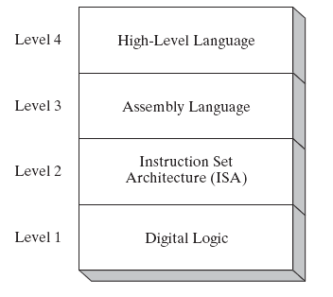
Specific Machine Levels
(descriptions of individual levels follow . . . )

Slide 18
High-Level Language
Level 4
Application-oriented languages
C++, Java, Pascal, Visual Basic . . .
Programs compile into assembly language (Level 3)

Slide 19
High-Level Language
The Java programming language is based on the virtual machine concept.
A program written in the Java language is translated by a Java compiler into Java byte code - a low-level language quickly executed at runtime by a program known as a Java virtual machine (JVM).

Slide 20
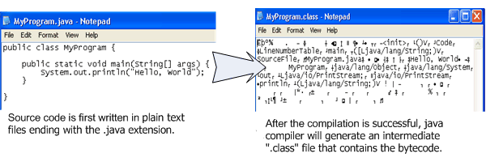
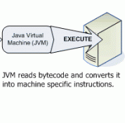
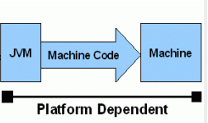
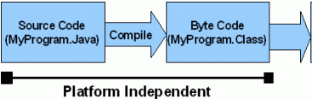
Interpret
Java code / Bytecode is always the same on different OS. That makes java program as platform independent.
JVM is platform dependent that means there are different implementation of JVM on different OS.

Slide 21
Assembly Language
Level 3
Instruction mnemonics that have a one-to-one correspondence to machine language
Programs are translated into Instruction Set Architecture Level - machine language (Level 2)
The instructions in assembly language may directly match the computer’s architecture or they may be translated during execution by a program inside the processor known as a microcode interpreter.

Slide 22
Instruction Set Architecture (ISA)
Level 2
Also known as conventional machine language
Executed by Level 1 (Digital Logic)

Slide 23
Digital Logic
Level 1
CPU, constructed from digital logic gates
System bus
Memory
Implemented using bipolar transistors

Slide 24
Basic Microcomputer Design
The central processor unit (CPU), where calculations and logic operations take place, contains a limited number of storage locations named registers, a high-frequency clock, a control unit, and an arithmetic logic unit.
The memory storage unit is where instructions and data are held while a computer program is running.
The storage unit receives requests for data from the CPU, transfers data from random access memory (RAM) to the CPU, and transfers data from the CPU into memory.
All processing of data takes place within the CPU, so programs residing in memory must be copied into the CPU before they can execute.

Slide 25
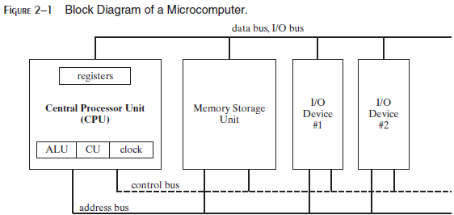
The central processor unit (CPU), where calculations and logic operations take place, contains a limited number of storage locations named registers, a high-frequency clock, a control unit, and an arithmetic logic unit.
The memory storage unit is where instructions and data are held while a computer program is running.

Slide 26
The storage unit receives requests for data from the CPU, transfers data from random access memory (RAM) to the CPU, and transfers data from the CPU into memory.
All processing of data takes place within the CPU, so programs residing in memory must be copied into the CPU before they can execute.

Slide 27
BUSES
A bus is a group of parallel wires that transfer data from one part of the computer to another.
A computer system usually contains four bus types: data, I/O, control, and address.
The data bus transfers instructions and data between the CPU and memory.
The I/O bus transfers data between the CPU and the system input/output devices.
The control bus uses binary signals to synchronize actions of all devices attached to the system bus.
The address bus holds the addresses of instructions and data when the currently executing instruction transfers data between the CPU and memory.

Slide 28
Clock Cycles
A machine instruction requires at least one clock cycle to execute.
Few require in excess of 50 clocks (the multiply instruction on the 8088 processor, for example).
Instructions requiring memory access often have empty clock cycles called wait states.
Because of the differences in the speeds of the CPU, the system bus, and memory circuits.

Slide 29
Instruction Execution Cycle
The CPU go through a predefined sequence of steps to execute a machine instruction, called the instruction execution cycle.
The instruction pointer (IP) register holds the address of the instruction we want to execute.

Slide 30
Instruction Execution Cycle
Here are the steps to execute it:
1. First, the CPU has to fetch the instruction from an area of memory called the instruction queue. It then increments the instruction pointer.
2. Next, the CPU decodes the instruction by looking at its binary bit pattern.
This bit pattern might reveal that the instruction has operands (input values).
3. If operands are involved, the CPU fetches the operands from registers and memory.
Sometimes, this involves address calculations.
4. Next, the CPU executes the instruction, using any operand values it fetched during the earlier step. It also updates a few status flags, such as Zero, Carry, and Overflow.
5. Finally, if an output operand was part of the instruction, the CPU stores the result of its execution in the operand.

Slide 31
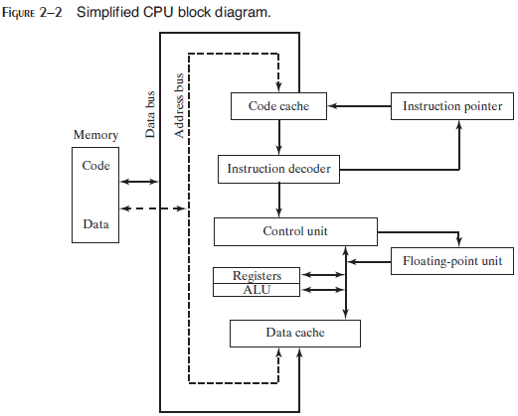
Instruction Execution Cycle
An operand is a value that is either an input or an output to an operation.
For example, the expression Z = X + Y has two input operands (X and Y) and a single output operand (Z).
In order to read program instructions from memory, an address is placed on the address bus.
Next, the memory controller places the requested code on the data bus, making the code available inside the code cache.

Slide 32
Instruction Execution Cycle
The instruction pointer’s value determines which instruction will be executed next.
The instruction is analyzed by the instruction decoder, causing the appropriate digital signals to be sent to the control unit, which coordinates the ALU and floating-point unit.
Control bus carries signals that use the system clock to coordinate the transfer of data between different CPU components.

Slide 33
Reading from Memory
As a rule, computers read memory much more slowly than they access internal registers.
Reading a single value from memory involves four separate steps:
Place the address of the value you want to read on the address bus.
Assert (change the value of) the processor’s RD (read) pin.
Wait one clock cycle for the memory chips to respond.
Copy the data from the data bus into the destination operand.
Each of these steps generally requires a single clock cycle,

Slide 34
Cache
CPU designers figured out that computer memory creates a speed bottleneck because most programs have to access variables.
To reduce the amount of time spent in reading and writing memory the most recently used instructions and data are stored in high-speed memory called cache.
The idea is that a program is more likely to want to access the same memory and instructions repeatedly, so cache keeps these values where they can be accessed quickly.
When the CPU begins to execute a program, it loads the next thousand instructions (for example) into cache, on the assumption that these instructions will be needed in the near future.
If there happens to be a loop in that block of code, the same instructions will be in cache.
When the processor is able to find its data in cache memory, we call that a cache hit.
On the other hand, if the CPU tries to find something in cache and it’s not there, we call that a cache miss.

Slide 35
X86 family Cache types
Cache memory for the x86 family comes in two types.
Level-1 cache (or primary cache) is stored right on the CPU.
Level-2 cache (or secondary cache) is a little bit slower, and attached to the CPU by a high-speed data bus.

Slide 36
why cache memory is faster than conventional RAM?
It’s because cache memory is constructed from a special type of memory chip called static RAM.
It’s expensive, but it does not have to be constantly refreshed in order to keep its contents.
On the other hand, conventional memory, known as dynamic RAM, must be refreshed constantly.
It’s much slower, but cheaper.

Slide 37
Loading and Executing a Program (1)
The operating system (OS) searches for the program’s filename in the current disk directory.
If it cannot find the name there, it searches a predetermined list of directories (called paths) for the filename.
If the OS fails to find the program filename, it issues an error message.
If the program file is found, the OS retrieves basic information about the program’s file from the disk directory, including the file size and its physical location on the disk drive.
The OS determines the next available location in memory and loads the program file into memory.
It allocates a block of memory to the program and enters information about the program’s size and location into a table (sometimes called a descriptor table).
Additionally, the OS adjust the values of pointers within the program so they contain addresses of program data.

Slide 38
Loading and Executing a Program (2)
The OS begins execution of the program’s first machine instruction (its entry point).
As soon as the program begins running, it is called a process.
The OS assigns the process an identification number (process ID), which is used to keep track of it while running.
It is the OS’s job to track the execution of the process and to respond to requests for system resources.
Examples of resources are memory, disk files, and input-output devices.
When the process ends, it is removed from memory.

Slide 39
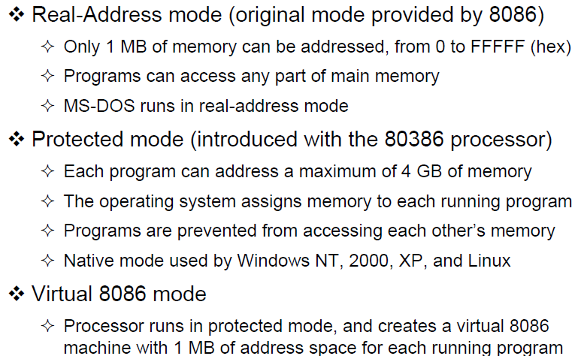
Mode of Operations
x86 processors have three primary modes of operation: protected mode, real-address mode, and system management mode. A sub-mode, named virtual-8086, is a special case of protected mode.
Implements the programming environment of the Intel 8086 processor
This mode is available in Windows 98, and can be used to run an MS-DOS program that requires direct access to system memory and hardware devices.
Programs running in real-address mode can cause the operating system to crash (stop responding to commands).
Slide Credit: Dr. Aiman El-Maleh & Dr. Kip Irvine

Slide 40
Mode of Operations
Protected mode is the native state of the processor, in which all instructions and features are available.
Programs are given separate memory areas named segments, and the processor prevents programs from referencing memory outside their assigned segments.
Slide Credit: Dr. Aiman El-Maleh & Dr. Kip Irvine

Slide 41
Mode of Operations
In protected mode, the processor can directly execute real-address mode software such as MS-DOS programs in a safe multitasking environment.
If an MS-DOS program crashes or attempts to write data into the system memory area, it will not affect other programs running at the same time.
Windows XP can execute multiple separate virtual-8086 sessions at the same time.
Slide Credit: Dr. Aiman El-Maleh & Dr. Kip Irvine

Slide 42
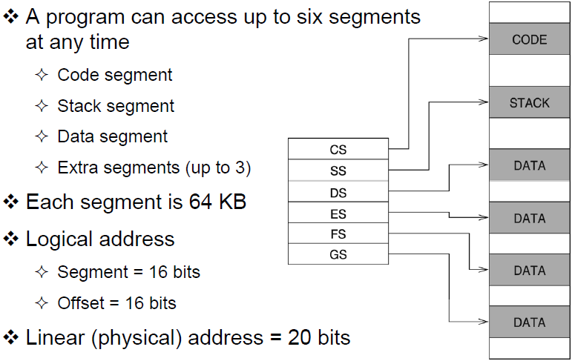
Real Address Mode (1)
Slide Credit: Dr. Aiman El-Maleh & Dr. Kip Irvine

Slide 43
Real Address Mode
Program Segments:
The code segment holds the program instruction codes.
The data segment stores data for the program.
The extra segment is an extra data segment (often used for shared data).
The stack segment is used to store interrupt and subroutine return addresses.

Slide 44
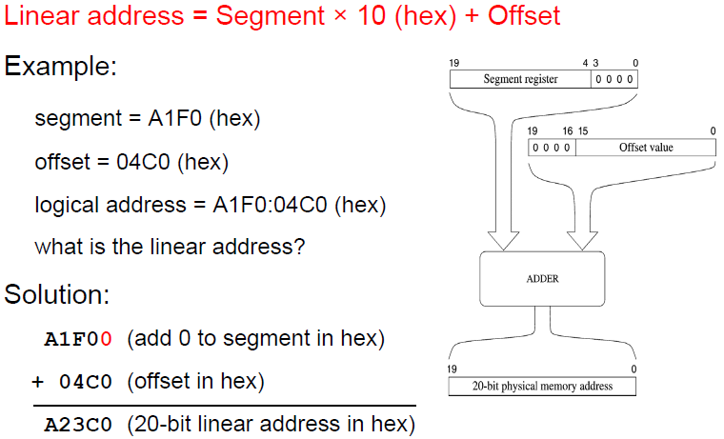
Real Address Mode (2)
Slide Credit: Dr. Aiman El-Maleh & Dr. Kip Irvine

Slide 45
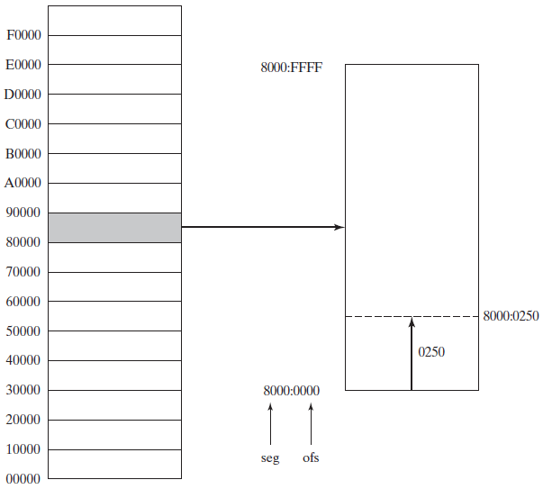
Real Address Mode (3)

Slide 46
Address Space
In 32-bit protected mode, a task or program can address a linear address space of up to 4 GBytes.
Extended Physical Addressing allows a total of 64 GBytes of physical memory to be addressed.
Real-address mode programs, on the other hand, can only address a range of 1 MByte.
If the processor is in protected mode and running multiple programs in virtual-8086 mode, each program has its own 1-MByte memory area.

Slide 47
Basic Program Execution Registers
Registers are high-speed storage locations directly inside the CPU, designed to be accessed at much higher speed than conventional memory.
There are eight general-purpose registers, six segment registers, a processor status flags register (EFLAGS), and an instruction pointer (EIP).

Slide 48
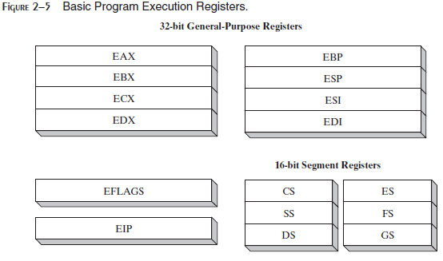

Slide 49
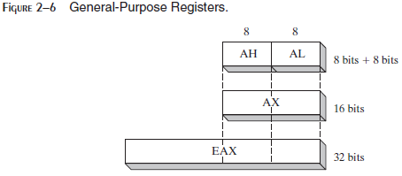
General-Purpose Registers:
The general-purpose registers are primarily used for arithmetic and data movement.
As shown in Figure 2–6, the lower 16 bits of the EAX register can be referenced by the name AX.
Portions of some registers can be addressed as 8-bit values.
For example, the AX register, has an 8-bit upper half named AH and an 8-bit lower half named AL.

Slide 50
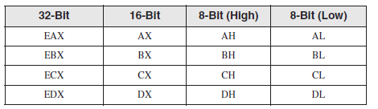
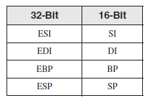
The remaining general-purpose registers can only be accessed using 32-bit or 16-bit names, as shown in the following table:

Slide 51
Specialized Uses
Some general-purpose registers have specialized uses:
• EAX is automatically used by multiplication and division instructions. It is often called the extended accumulator register.
• The CPU automatically uses ECX as a loop counter.
• ESP (extended stack pointer register) addresses data on the stack (a system memory structure). It is rarely used for ordinary arithmetic or data transfer.
• ESI and EDI (extended source index and extended destination index ) are used by high-speed memory transfer instructions.
• EBP is used by high-level languages to reference function parameters and local variables on the stack. It should not be used for ordinary arithmetic or data transfer except at an advanced level of programming. It is often called the extended frame pointer register.

Slide 52
Segment Registers:
In real-address mode, 16-bit segment registers indicate base addresses of pre-assigned memory areas named segments.
In protected mode, segment registers hold pointers to segment descriptor tables (The descriptor describes the location, length and access rights of the memory segment).
Some segments hold program instructions (code), others hold variables (data), and another segment named the stack segment holds local function variables and function parameters.
Instruction Pointer :
The EIP, or instruction pointer, register contains the address of the next instruction to be executed.
Certain machine instructions manipulate EIP, causing the program to branch to a new location.

Slide 53
EFLAGS Register:
The EFLAGS (or just Flags) register consists of individual binary bits that control the operation of the CPU or reflect the outcome of some CPU operation.
A flag is set when it equals 1; it is clear (or reset) when it equals 0.
Control Flags:
Control flags control the CPU’s operation.
For example, they can cause the CPU to break after every instruction executes, interrupt when arithmetic overflow is detected, enter virtual-8086 mode, and enter protected mode.
Programs can set individual bits in the EFLAGS register to control the CPU’s operation.
Examples are the Direction and Interrupt flags.

Slide 54
Status Flags
The Status flags reflect the outcomes of arithmetic and logical operations performed by the CPU. They are the Overflow, Sign, Zero, Auxiliary Carry, Parity, and Carry flags.
The Carry flag (CF) is set when the result of an unsigned arithmetic operation is too large to fit into the destination.
The Overflow flag (OF) is set when the result of a signed arithmetic operation is too large or too small to fit into the destination.
The Sign flag (SF) is set when the result of an arithmetic or logical operation generates a negative result.

Slide 55
The Zero flag (ZF) is set when the result of an arithmetic or logical operation generates a result of zero.
The Parity flag (PF) is set if the least-significant byte in the result contains an even number of 1 bits. Otherwise, PF is clear. In general, it is used for error checking when there is a possibility that data might be altered or corrupted.

Slide 56
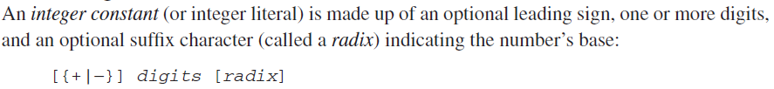
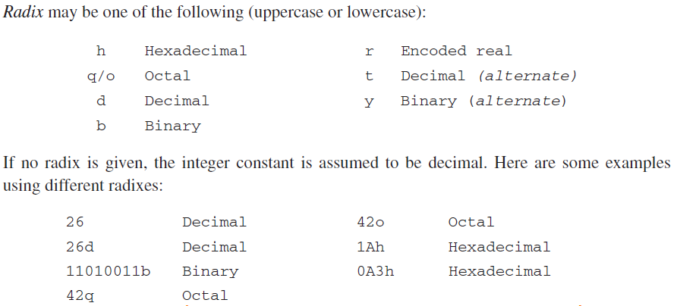
Integer Constants

Slide 57
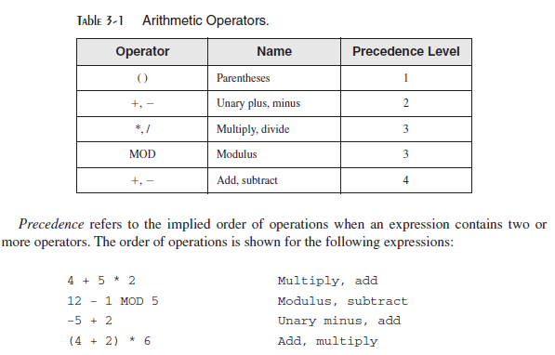
Integer Expressions
An integer expression is a mathematical expression involving integer values and arithmetic operators.
The integer expression must evaluate to an integer, which can be stored in 32 bits (0 through FFFFFFFFh).

Slide 58
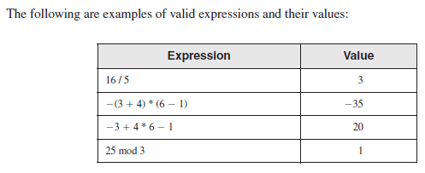

Slide 59
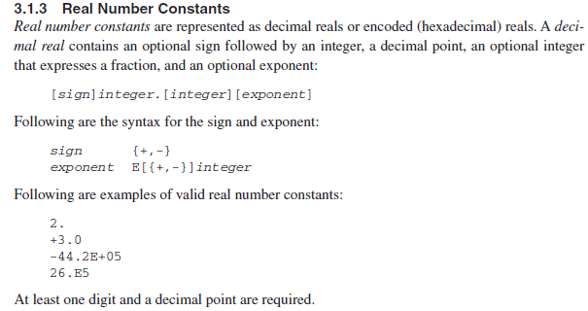

Slide 60
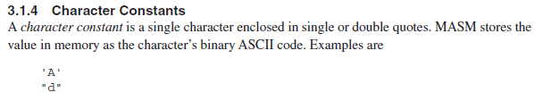

Slide 61
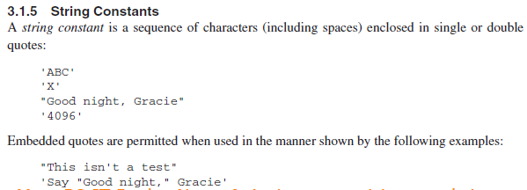
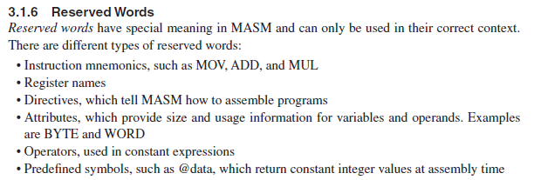

Slide 62
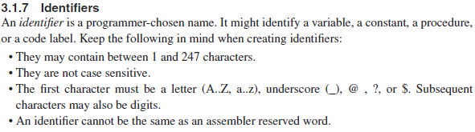
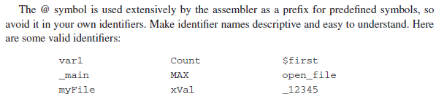

Slide 63
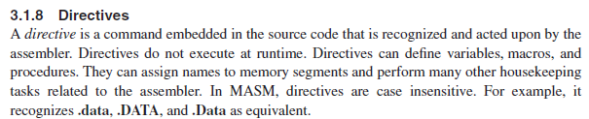
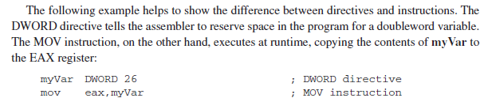
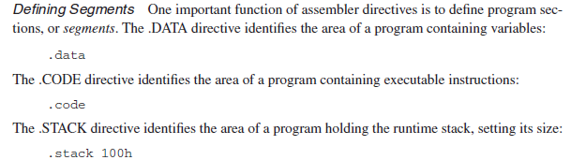

Slide 64
Directives
Commands that are recognized and acted upon by the assembler
Not part of the Intel instruction set
Used to declare code, data areas, select memory model, declare procedures, etc.
not case sensitive
Different assemblers have different directives
NASM not the same as MASM, for example
myVar DWORD 26 ; DWORD directive, set aside
; enough space for double word
Mov eax, myVar ; MOV instruction

Slide 65
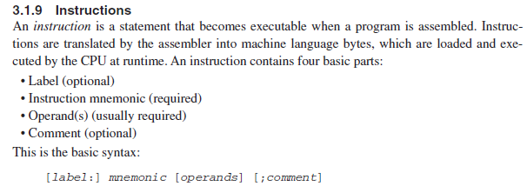

Slide 66
Instructions
An instruction is a statement that becomes executable when a program is assembled.
Assembled into machine code by assembler
Executed at runtime by the CPU
We use the Intel IA-32 instruction set
An instruction contains:
Label (optional)
Mnemonic (required)
Operand (depends on the instruction)
Comment (optional)
Basic syntax
[label:] mnemonic [operands] [ ; comment]

Slide 67
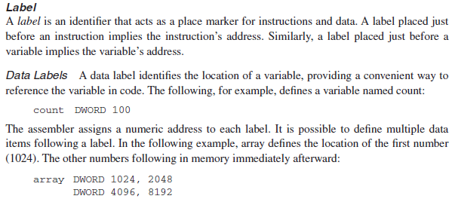

Slide 68
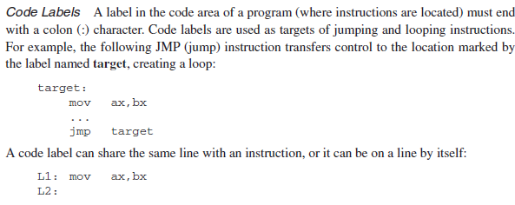

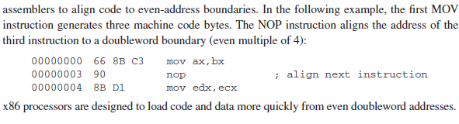

Slide 69
Labels
Act as place markers
marks the address (offset) of code and data
Follow identifer rules
Data label
must be unique
example: myArray (not followed by colon)
count DWORD 100
Code label
target of jump and loop instructions
example: L1: (followed by colon)
target:
mov ax, bx
…
jmp target

Slide 70
Mnemonics and Operands
Instruction Mnemonics
memory aid
examples: MOV, ADD, SUB, MUL, INC, DEC
Operands
constant 96
constant expression 2 + 4
register eax
memory (data label) count
Constants and constant expressions are often called immediate values

Slide 71
Instruction Format Examples
No operands
stc ; set Carry flag
One operand
inc eax ; register
inc myByte ; memory
Two operands
add ebx,ecx ; register, register
sub myByte,25 ; memory, constant
add eax,36 * 25 ; register, constant-expression

Slide 72

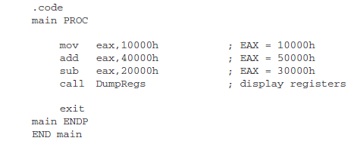

Slide 73
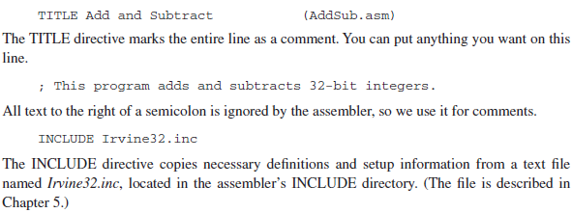

Slide 74
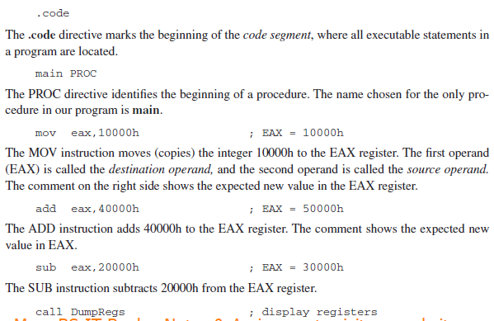

Slide 75
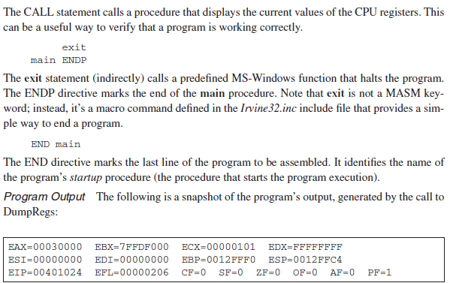

Slide 76
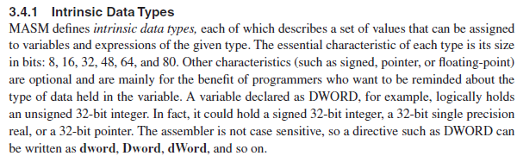

Slide 77
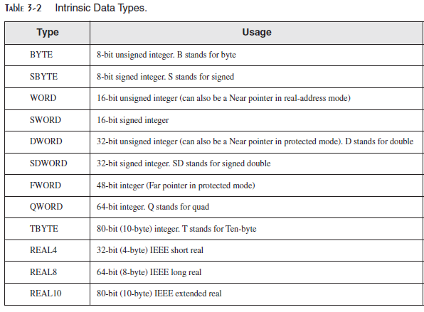

Slide 78
.data
promptUse byte "Enter two integers: ", 0
results byte "Result is: ", 0
.code
main proc
mov esi, offset array
mov ecx, int_count
l1:
mov edx, offset promptUser
call writestring
call readint
mov [esi],eax
add eax, [esi]
add esi, type dword
loop l1
mov edx, offset results
call writestring
call writeint
exit
main endp
end main

